Slide 1
A QUADCOPTER PROVIDING WIRELESS LOCAL AREA NETWORK
Guided by:
Mr Ajai V Babu
Asst. Professor
Dept. ECE
RSET
Presented by:
Jafis P C
Roll No 13
VAES S2
RSET

Slide 2
OBJECTIVE
Design of a drone that provides wireless local area network
Implement Wi-Fi based network
Establish Wi-Fi to Wi-Fi communication network
Drone navigation with GPS, Accelerometer and Compass sensor aid

Slide 3
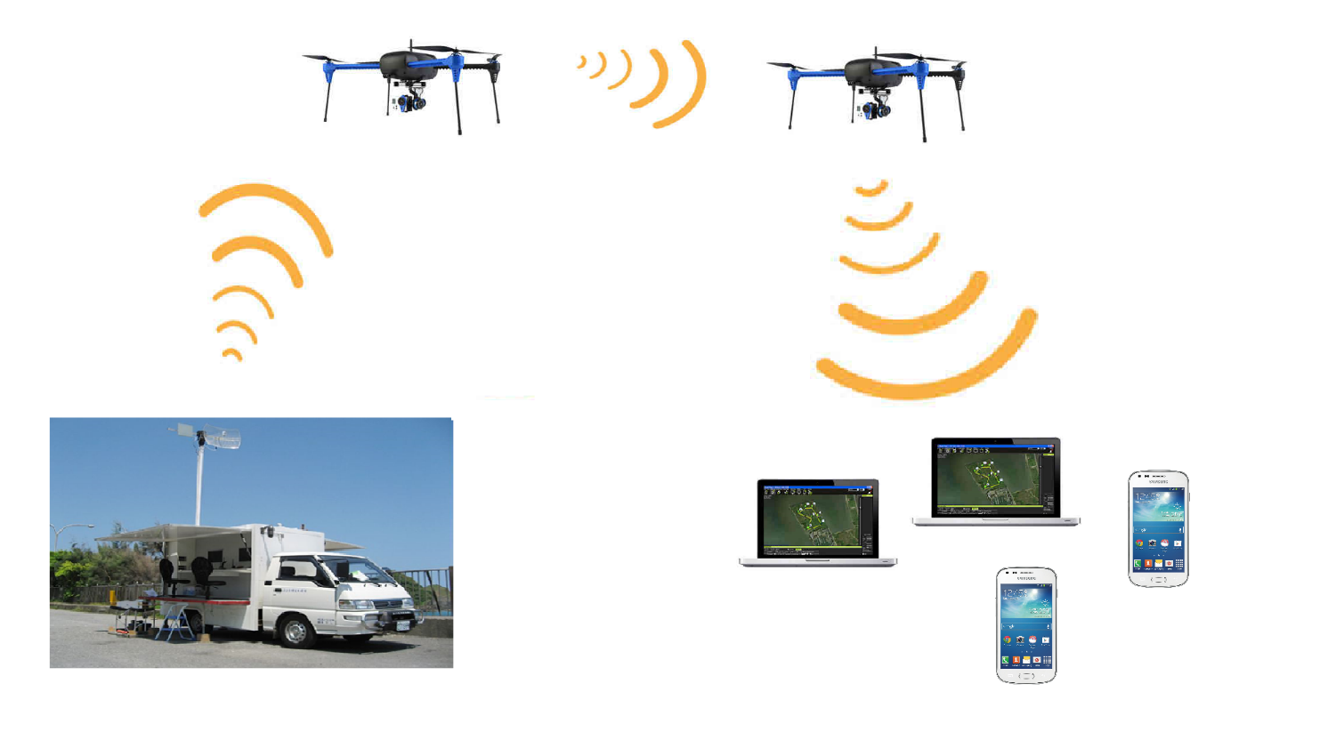
CONCEPTUAL DIAGRAM

Slide 4
BLOCK DIAGRAM
Flight control unit
Raspberry pi3
Accelero- meter
Remote control unit
GPS
Wi-Fi Module
(client)
Compass
Ground
station
Wi-Fi Dongle
(AP)
PDAs

Slide 5
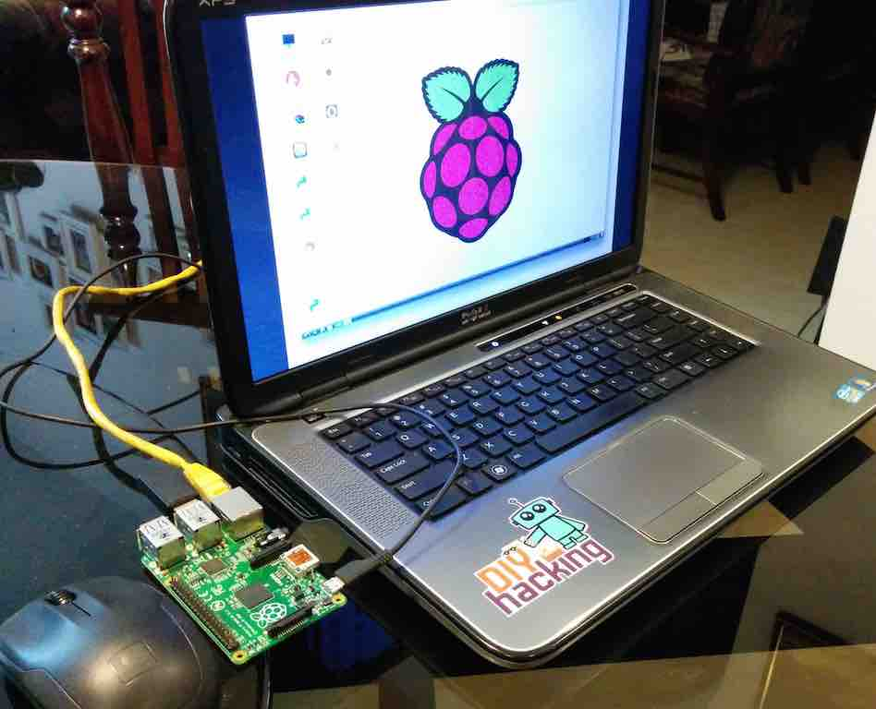
WORK DONE
Initialisation
Downloading and installing Raspbian OS on Pi3
Setting up the Pi and updating configurations and firmware
Set up the VNC server to connect Raspberry Pi to a laptop display

Slide 6
Wi-Fi network implementation
Implementing Wi-Fi to Wi-Fi communication
Two Wi-Fi modules are used
One module act as Wi-Fi client
Second One Act as Wi-Fi access point
On board Wi-Fi module and USB Wi-Fi dongle are used

Slide 7
STEPS
Connect Wi-Fi module and Ethernet
Check everything is intact
Install required software packages like Hostapd, isc-dhcp server, etc..
Backup default configuration files
Configure Static IP to Wi-Fi module
Create Access point (AP)
Enable IP forwarding and Packet data Routing
Reboot

Slide 8
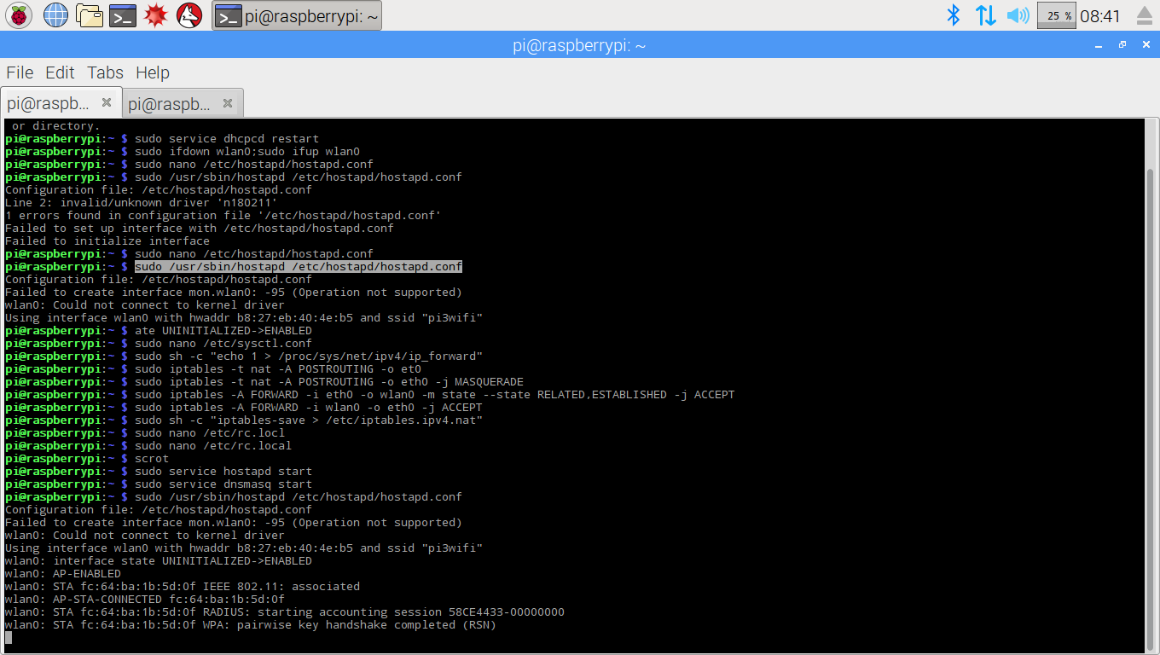
RESULT

Slide 9
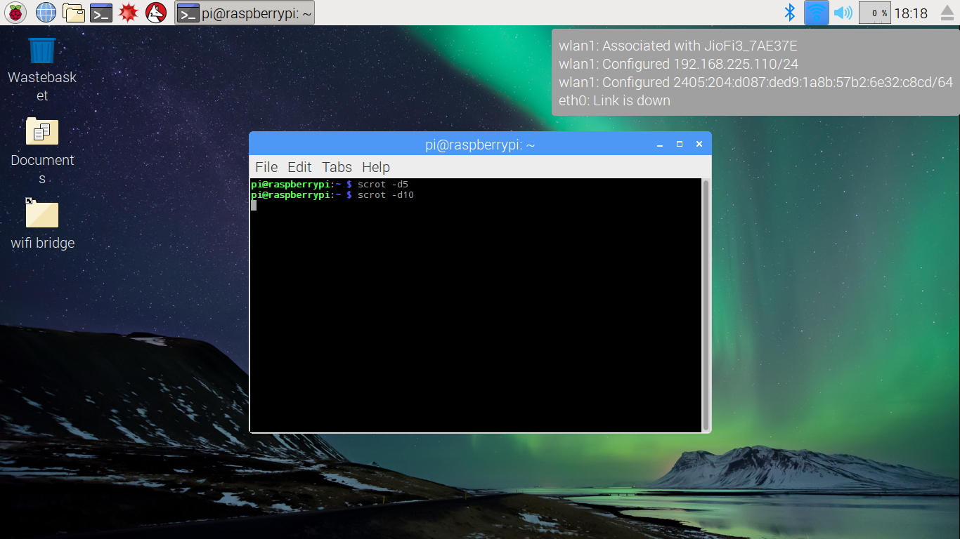
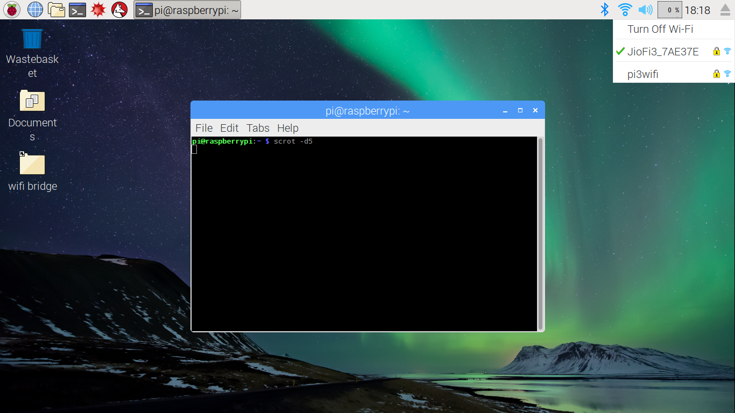
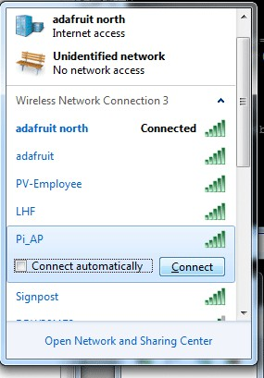

Slide 10
REFERENCE
[Online].Available: https://learn.adafruit.com/setting-up-a-raspberry-pi-as-a-wifi-accesspoint
[Online].Available: https://blog.bitify.co.uk/2013/11/reading-data-from-mpu-6050-on-raspberry.html
[Online].Available: https://www.raspberrypi.org/documentation
[Online].Available: https://frillip.com/using-your-raspberry-pi3-as-a-wifi-access-point-with-hostapd
[Online].Available: https://elinux.org/RPI_USB_Wi-Fi_Adapters
[Online].Available: https://github.com/
[Online].Available: https://en.m.Wikipedia.org/

